Slide 1
World Energy Trilemma Index 2022
Paul Appleby, Chief Insights Officer
Presentation at SNK WEC Section meeting – November 30th 2022

Slide 2
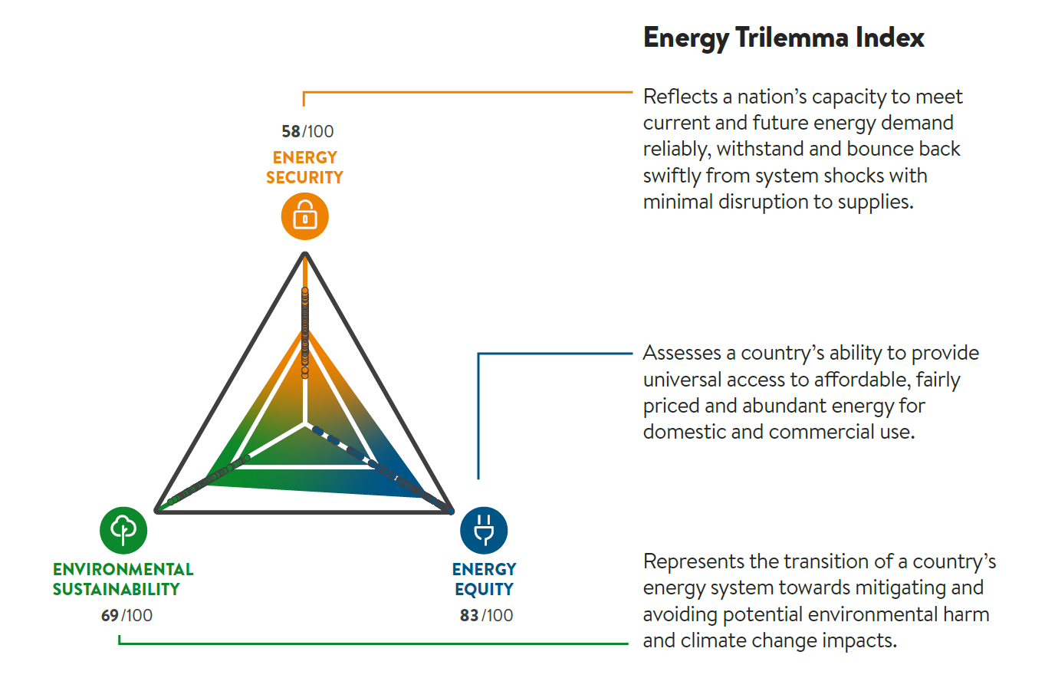
A balanced approach to energy policy
World Energy
Trilemma Index
2

Slide 3
World Energy Trilemma Results – Top 10 Rank

Slide 4
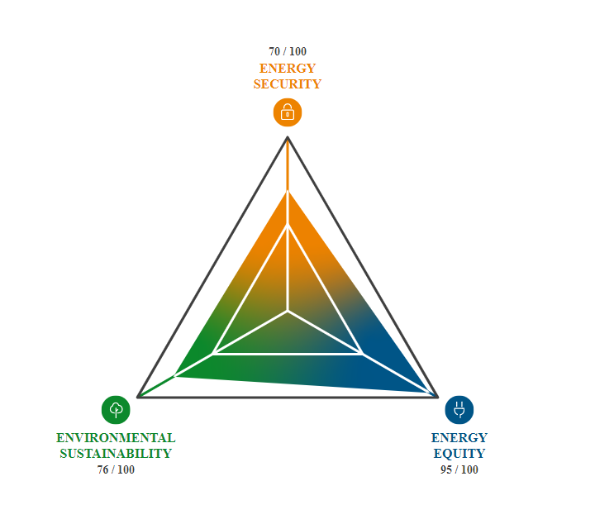
World Energy Trilemma Results – Slovenia
Overall score: 78.8, rank #9.
Energy Security: 69.8, rank #17. Increasing across all indicators over past decade.
Energy Equity: 94.7, rank #18. Affordability of electricity remains a challenge.
Sustainability: 76.0, rank #26. CO2 intensity improving with increasing low carbon power, but energy sector CH4 emissions are a drag on Slovenia’s score.

Slide 5
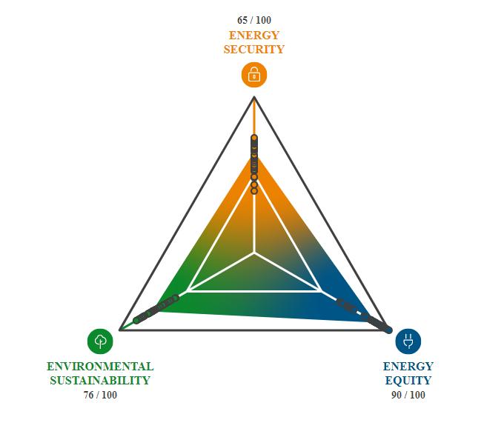
World Energy Trilemma Results – Europe
Compared to the European average:
Slovenia outperforms on Energy Security and Energy Equity
Slovenia matches average for Environmental Sustainability.

Slide 6
World Energy Trilemma – our agenda
Continuous improvement of the World Energy Trilemma Index
More timely data
Better ways to measure system resilience
How to represent and measure “justice” in energy transitions
Extending the Trilemma framework with new capabilities
Scalable Trilemma
Flexible Trilemma
Requires significant re-investment by the World Energy Council community, working with funding partners

Slide 7
The World Energy Scalable Trilemma
The Scalable World Energy Trilemma extends the Trilemma framework to either the national, state, or city level with a bespoke set of indicators. A limited number of global indicators can be used along with new standardized indicators as per the user’s requirements. There are several ways to use the framework:
Expanding the World Energy Trilemma Index methodology to administrative regions within a nation, or neighbourhoods within a city and using custom data sources for the region.
Where historical data is available, the scalable Trilemma can be used to benchmark progress towards local transition goals. Examining the long-term trends of the Trilemma at a city dimension can help policy makers implement changes that are circumspect of all elements of a just transition.

Slide 8
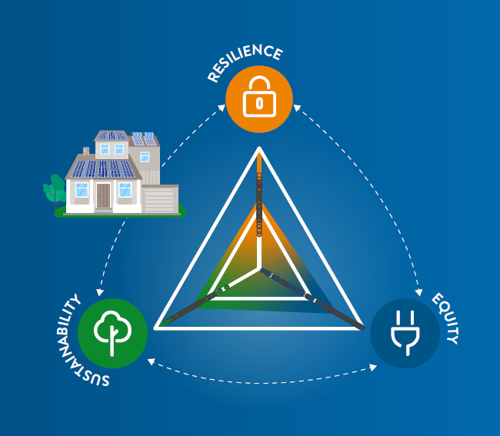
The Flexible World Energy Trilemma
The Flexible World Energy Trilemma uses the Trilemma Framework to scope a problem for decision-making. It then extends beyond establishing an index, by producing a highly bespoke localized pathfinding tool from gathered data. It is adaptable based on the granular level of decision making that is required by the user. The Flexible Trilemma's indicators and associated weightings can be organized and structured as desired by the user. By exploring sensitivities and dependencies between the indicators, the flexible Trilemma can enable the simulation of possible policy evaluations in a region.

Slide 9
Contact
Paul Appleby
Chief Insights Officer
appleby@worldenergy.org

Slide 10
ABOUT THE WORLD ENERGY COUNCIL
Formed in 1923, the World Energy Council is the world’s first permanent energy organisation and a registered charity.
We are an open-to-all and fully independent world energy community. We do not advocate for any country, company, resource, technology or solution.
Our enduring mission focusses on “how to” secure better energy for humanity in the current era of energy for people and planet.
Globally networked and locally strong, we work dynamically with 3,000+ member organisations, in nearly 90 countries, across all energy sectors.
In 2019, the World Energy Council launched a new vision of ‘Humanising Energy’ which has rapidly come of age in the global health emergency.
World Energy Council
Registered in England and Wales
No. 4184478 VAT Reg. No. GB 123 3802 48
Registered Office
62-64 Cornhill London
EC3V 3NH
United Kingdom
FOLLOW US ON SOCIAL MEDIA
Twitter -@WECouncil
Linkedin -World Energy Council

